Slide 1

YouTube Clone (Group no 9)
Aditya Desai | 19 | SE IT A
Mukund Dhanuka | 20 | SE IT A
Aayushi Dubey | 22 | SE IT A
Khushi Mishra | 59 | SE IT A

Slide 2
PROBLEM STATEMENT
The problem statement for the YouTube clone project is to create a web application that allows users to upload, view, and share videos, as well as interact with other users through comments, likes, and subscriptions. The clone should also provide a user-friendly interface and an efficient video streaming experience.
Create a web application that replicates the core functionality of YouTube, allowing users to upload, view, and share videos. The YouTube clone should provide a familiar user experience while offering essential features such as user registration, video uploading, video playback, comments, likes, and a subscription system.

Slide 3
ABSTRACT
This presentation is a comprehensive overview of the YouTube clone. The project aimed to create a replica of the popular video-sharing platform, YouTube, by implementing various features and functionalities.
The YouTube clone project was initiated with the goal of creating a platform that mimics the core functionalities of YouTube, a popular video-sharing website. The project aimed to replicate the basic features of YouTube, including user registration, video uploading, video playback, commenting, and user engagement.

Slide 4
INTRODUCTION
The aim of this project is to develop a web application that replicates the core functionalities of YouTube, one of the most popular video-sharing platforms on the internet. By creating a YouTube clone, we aim to gain a deeper understanding of web development technologies, databases, and user authentication systems.
The YouTube Clone project holds immense significance for educational purposes. By engaging in the development of a video-sharing platform, students gain insights into various aspects of web development, including frontend design and user interaction.
This project also allows for exploration of emerging technologies and techniques in the field of web development.

Slide 5
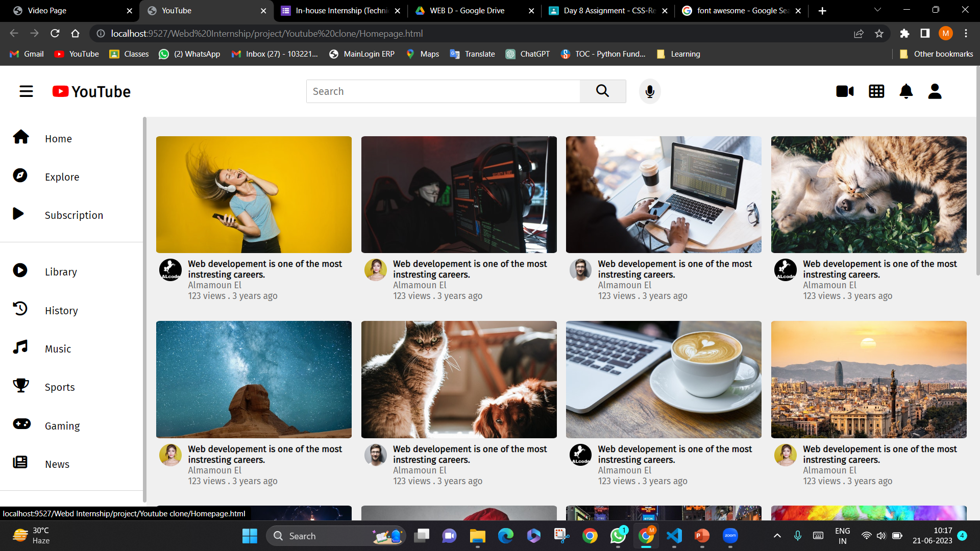
IMPLEMENTATION

Slide 6
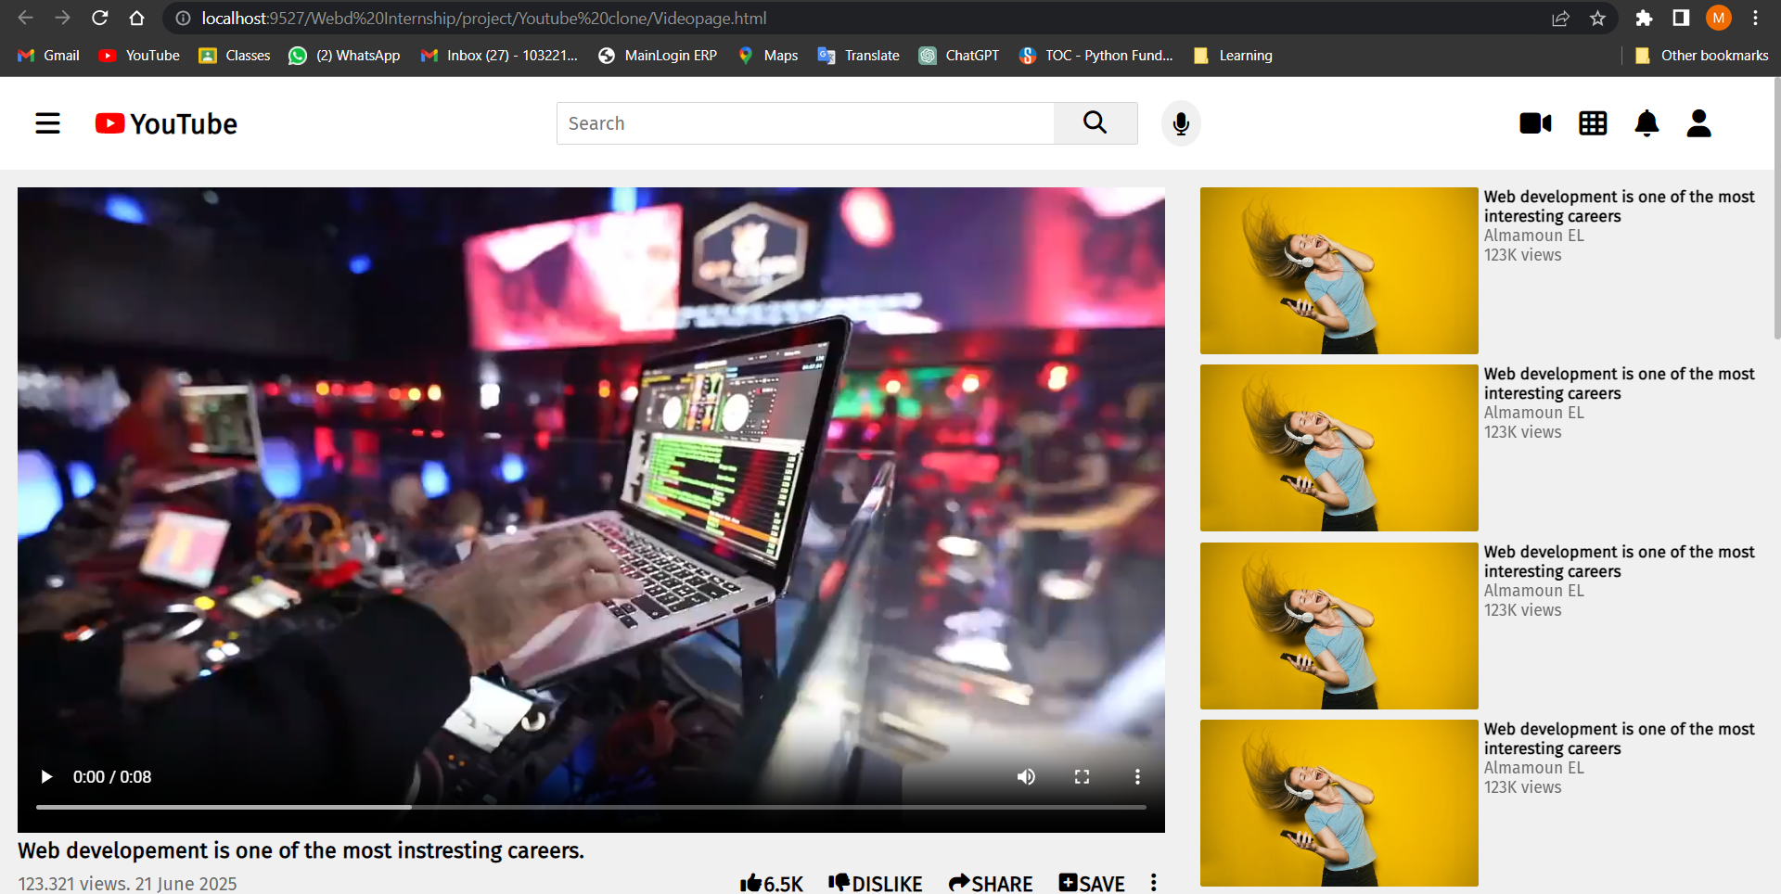
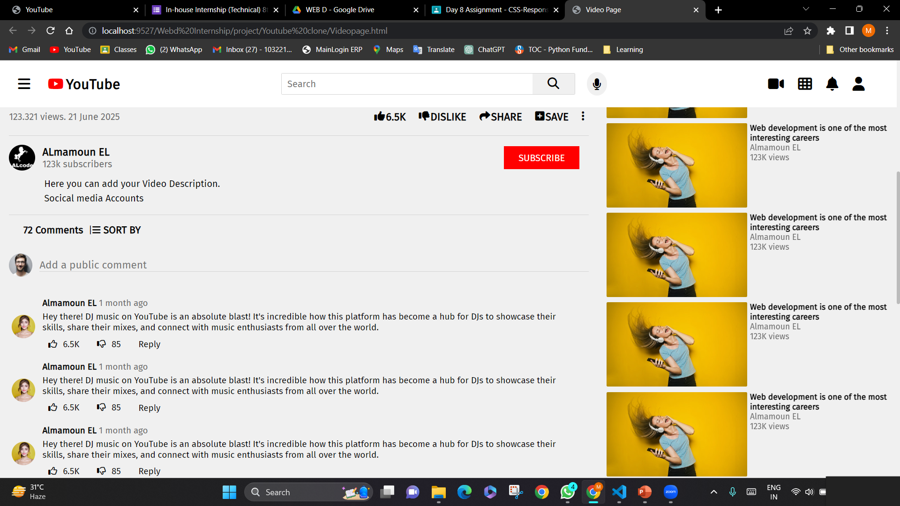

Slide 7
RESULTS & DISCUSSION
Video Upload and Viewing: The YouTube Clone provided users with the ability to upload videos, which were stored on the server and made accessible for viewing. Video playback functionality, including pause, play, and seek, was implemented and demonstrated satisfactory performance.
Social Interactions: Users were able to comment on videos, like or dislike them, and subscribe to channels. These interactions were properly recorded and displayed, facilitating user engagement and community building.

Slide 8
RESULTS & DISCUSSION
Responsive Design: The YouTube Clone was developed with a responsive design, ensuring compatibility and optimal viewing experience across various devices and screen sizes.
Future Enhancements: To further improve the YouTube Clone, several enhancements can be considered. These include implementing a more robust recommendation algorithm using machine learning techniques, integrating a real-time notification system, enhancing the video upload process for better performance, and incorporating more advanced social features like user playlists and trending videos.

Slide 9
FUTURE SCOPE
The YouTube Clone project has significant potential for expansion and improvement. Some of the future enhancements and features that can be considered include:
Recommendation System: Implement an intelligent recommendation system that suggests relevant videos based on user preferences, browsing history, and video popularity.
Live Streaming: Incorporate live streaming capabilities to enable users to broadcast and interact with real-time events, fostering engagement and community-building.
Social Integration: Integrate social media platforms to allow users to share videos easily across various networks, enhancing the reach and virality of content.
Connect to Database

Slide 10
FUTURE SCOPE
Mobile Application: Develop a mobile application version of the YouTube Clone project to expand the user base and provide a more convenient and accessible user experience.
Analytics and Insights: Incorporate analytics and data visualization features to provide users and content creators with detailed insights into video performance, audience demographics, and engagement metrics.
Enhanced Content Moderation: Implement advanced content moderation techniques, including automated flagging and filtering mechanisms, to maintain a safe and positive user experience.
Multi-language Support: Introduce support for multiple languages to cater to a global audience, enabling users to browse and interact with the platform in their preferred language.

Slide 11
CONCLUSION
The YouTube Clone project successfully replicated core functionalities of the YouTube platform, providing users with the ability to upload, share, and view videos, comment and rate videos, manage user profiles, and implement a subscription and notification system. The project faced various challenges during implementation, but through the utilization of appropriate technologies and frameworks, these challenges were overcome. The YouTube Clone project serves as a comprehensive demonstration of the knowledge and skills acquired during the program.
The YouTube clone project has been successfully developed and implemented as part of the project. The objective of the project was to create a web application that mimics the functionality and features of the popular video-sharing platform, YouTube.

Slide 12
TECHNOLOGIES USED
a) Front-end Technologies:
HTML5
CSS3
JavaScript
b) Additional Tools and Libraries:
Git
GitHub
Google fonts
Font Awesome

Slide 13
REFERENCES
https://developers.google.com/youtube/
https://github.com/WWBN/AVideo
https://github.com/mediadrop/mediadrop
https://ffmpeg.org/
https://github.com/video-dev/hls.js/
https://getbootstrap.com/
https://mui.com/core/
https://www.docker.com/

Slide 14
THANK YOU

